Slide 1

IPL 2026 Dream Team Selection
Team-2(CSK)
Team members:
Chirag B A
Jilpha Susmith
K Prabhavathi
Adduri Nikhil
Sarva Vaishnavi

Slide 2
Problem Statement
The franchise needs a data-backed method to build its IPL 2026 squad under budget and regulatory constraints. The challenge is to evaluate players across performance, cost efficiency, consistency, and pitch suitability to create the optimal squad and Playing XI that maximizes winning probability while maintaining a risk-mitigated and balanced team structure.

Slide 3
Objective
The primary objective is to construct a high-performing IPL 2026 squad that can consistently deliver winning outcomes. This involves
Win IPL 2026 tournament
Maximizing home-ground success
Build strategically balanced and sustainable team composition
ensuring full adherence to IPL regulations

Slide 4
Key Constraints & Rules
Squad Rules
Budget Limit: ₹125 Cr
Squad Size: 18–25 players
Mandatory: Selection of a Playing XI
IPL Regulations
At least one wicket-keeper must be included
Maximum of 8 foreign players allowed in the squad

Slide 5
Dataset Overview
Batsmen Metrics
Bowler Mertics
All rounder Metrics
Runs, Strike Rate
Boundary %
Batting Average
Batting Impact Score
Wickets, Economy, Dot balls
Dot ball %
Bowling Impact Score
Efficiency Metrics
Combined Impact Score
Experience Score

Slide 6
Data Cleaning
Data Issues Identified
Cleaning Actions Performed
Missing / zero values across role-based score columns
Separate performance columns for batsman, bowler, all-rounder, wicket-keeper
Inconsistent role labels
Mixed numeric & text formats
Raw dataset not directly usable for analysis
Removed blanks and duplicate players
Replaced missing scores with 0
Standardized role names (Batsman, Bowler, All-Rounder, Wicket-Keeper)
Converted price and score columns to numeric
Validated each player belongs to only one role
Outcome:Clean, structured, analysis-ready dataset

Slide 7
Pre-processing & Feature Engineering
New Features Created
Transformations Applied
Final_Player_Score:Overall player performance metric
Role flags : Is_Batsman, Is_Bowler, etc.
Player Ranking :Sorted by performance
Role-wise aggregation
Average performance calculation
Why this Step?
Enables fair comparison across players and supports data-driven team selection

Slide 8
Model Selection
Linear Programming (LPP)
Linear Programming is a technique used to Maximize or minimize an objective function subject to constraints
Components
Objective Function → What to maximize/minimize
Decision Variables → What to choose
Constraints → Budget, rules, limits
Used in
Supply chain optimization
Portfolio selection

Slide 9
Why LPP for IPL Team Selection
Reasons for Choosing LPP
Budget restriction (price constraint)
Fixed team size
Role composition rules
Need maximum total performance
Many combinations (millions possible)
Without LPP
Manual trial & error
Time consuming
Sub-optimal team

Slide 10
Model Inputs
Player Features
Final_Player_Score (Impact Score)
Sold_Price
Role flags (BAT/BOWL/AR/WK)
Derived Columns
Is_Batsman
Is_Bowler
Is_AllRounder
Is_WicketKeeper
Interpretation
Score → Performance contribution
Price → Cost
Flags → Role eligibility

Slide 11
Selection Workflow
Step-by-Step Process
Clean dataset
Compute Impact Scores
Create Final_Player_Score
Build Linear Programming model
Apply constraints
Solve using PuLP solver
Get optimal squad
Select best Dream11 XI

Slide 12
Final performance score concept
Objective
Evaluate players within their specific roles using cricket-relevant performance metrics.
Why Role-Based?
Batsmen, Bowlers, All-Rounders, and Wicket-Keepers contribute differently
Same metrics cannot measure all roles fairly
Separate evaluation improves accuracy

Slide 13
Approach
Role-specific features selected
Linear Programming optimized weights
Final score = weighted sum of features
Used as objective function in squad selection
This converts multi-dimensional performance into a single comparable score

Slide 14
LPP-Based weight Optimization & Score Calculation
Linear Programming Maximization (PuLP)
Decision variables → feature weights
Objective → maximize total impact
Constraint → sum of weights = 1
Cricket-based importance rules applied
Apply Home Ground and Foreign Player Logic
Finds optimal feature importance automatically

Slide 15
Full Squad Vs Dream XI Selection
Stage 1 — Full Squad (18 players)
Budget constrained
Role balanced
Maximize total score
Stage 2 — Dream 11
Select best playing XI
From selected 18 only
Maximize on-field performance
Why 2 stages?
Real IPL process
Bench strength maintained
Tactical flexibility

Slide 16
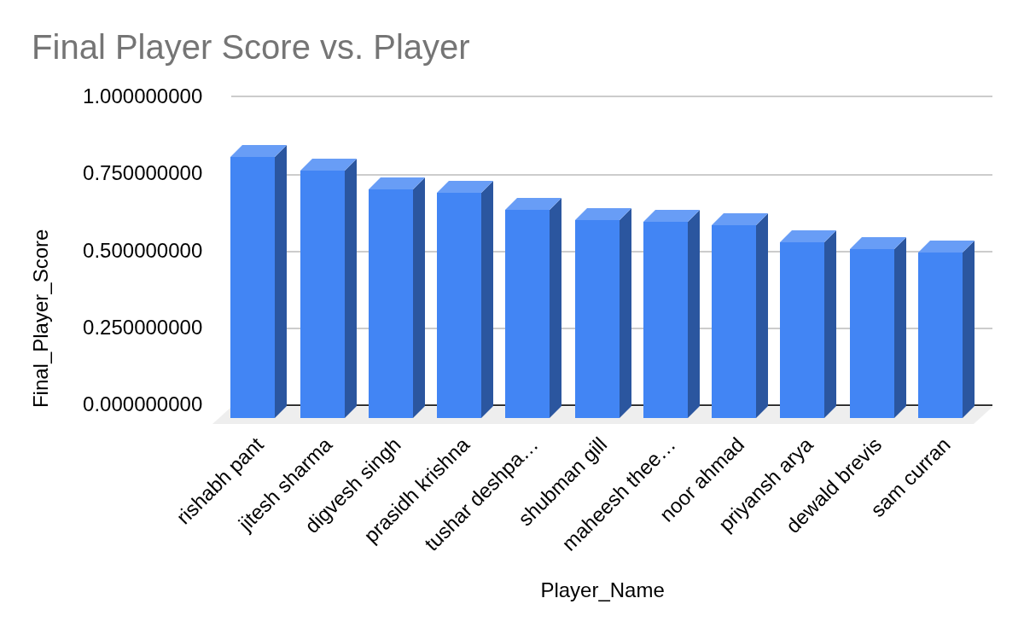
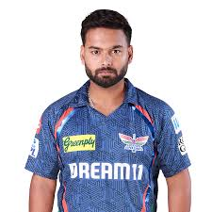
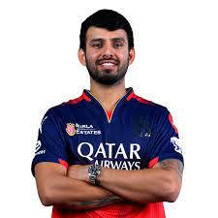



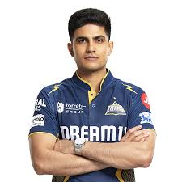
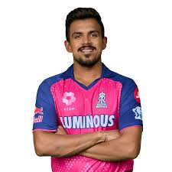





Slide 17
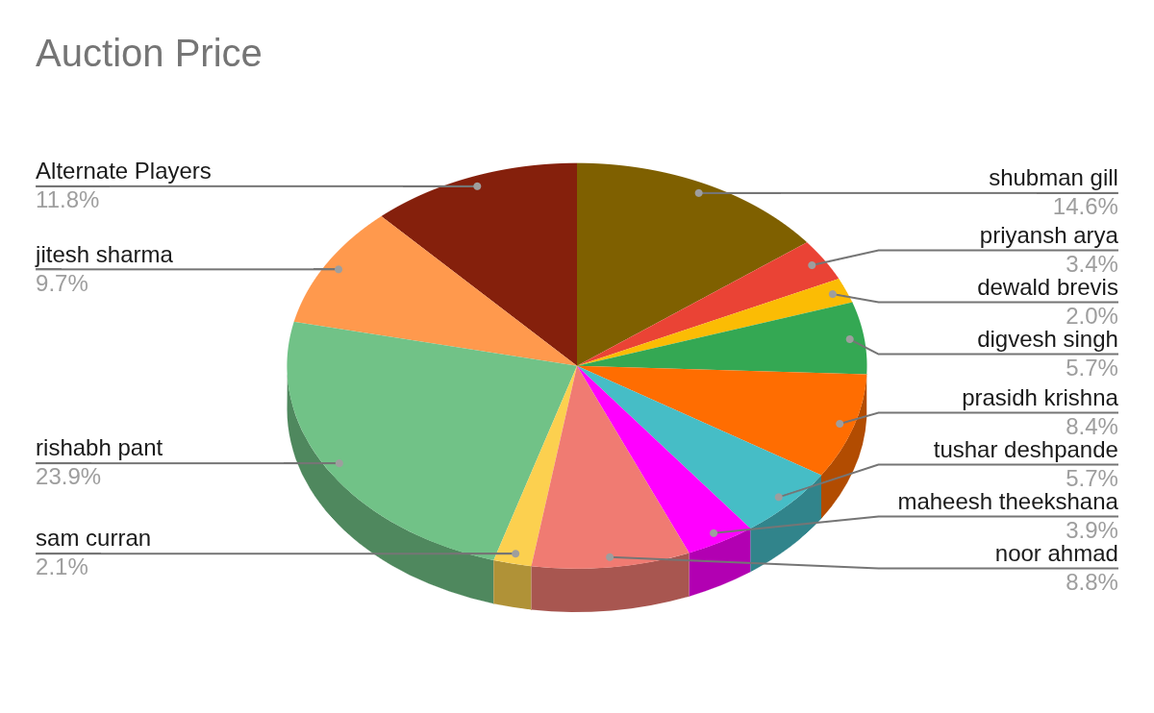

Slide 18
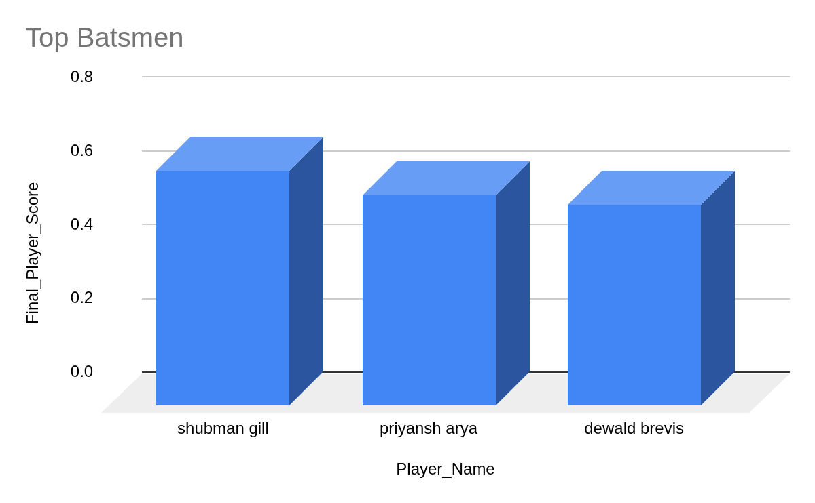

Slide 19
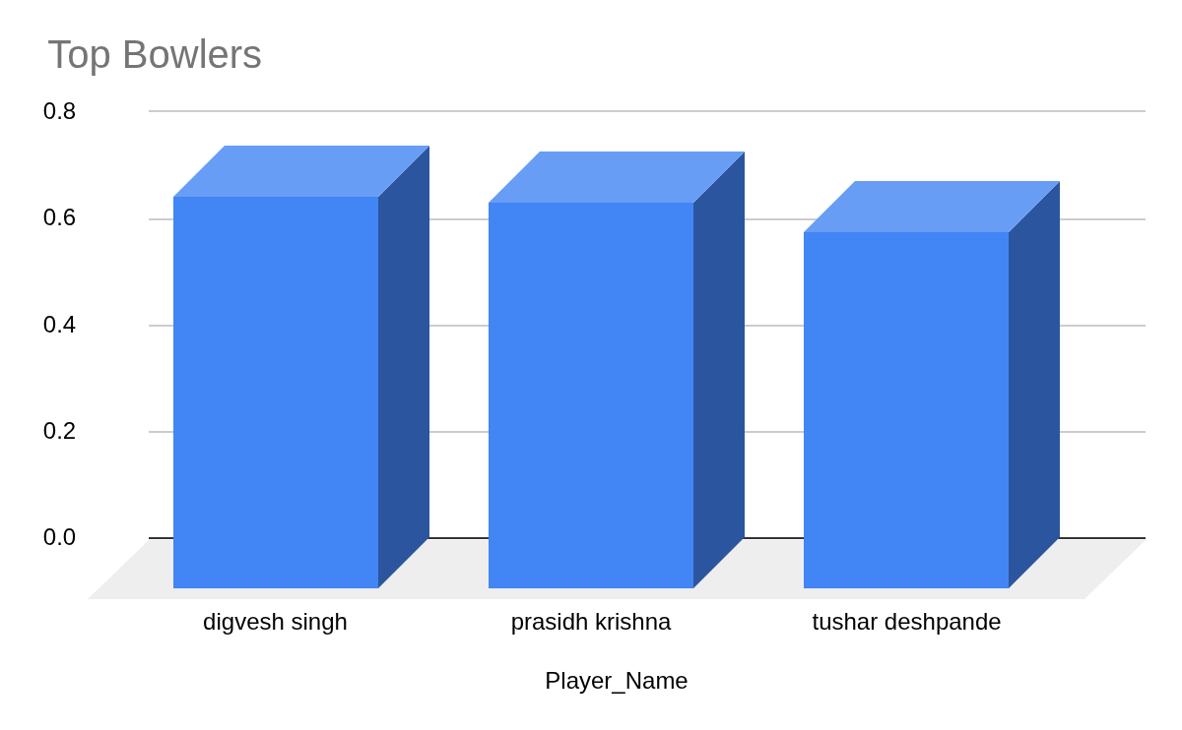


Slide 20
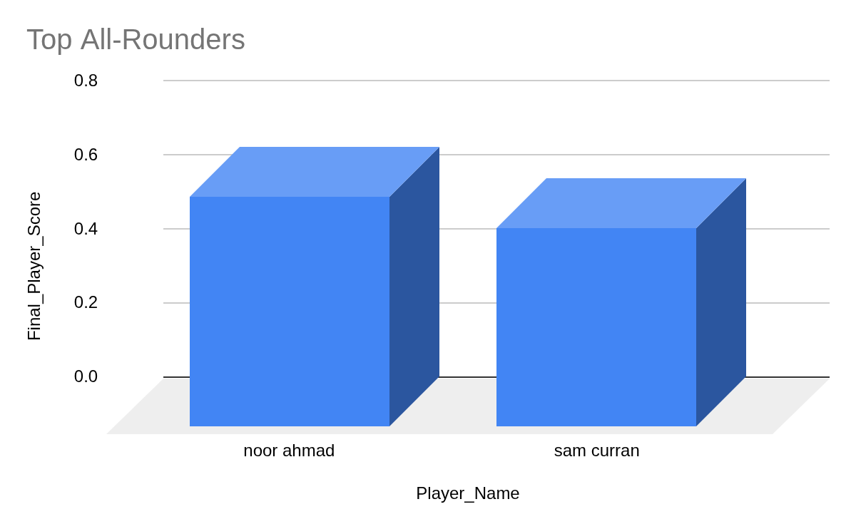

Slide 21
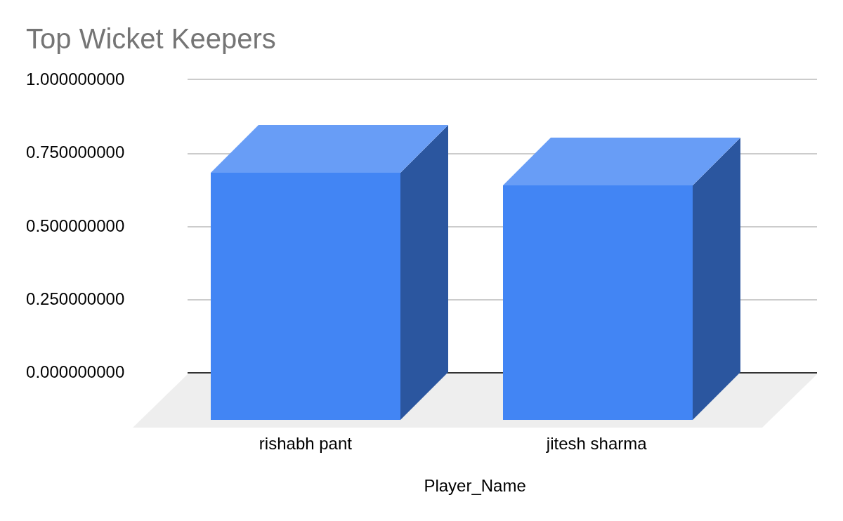
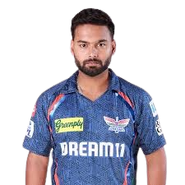

Slide 22
Limitations of Model
Dependence on Historical Performance Data
Static Impact Scores vs Dynamic Match Conditions
Linear Assumptions in Player Contribution
Simplified Role Classification
Data Quality & Feature Limitations

Slide 23
Future Enhancements
Planned Improvements
Live Form Integration
Include recent match performance instead of only historical averages
Match Condition Factors
Add pitch type, venue, weather, and opponent strength
Dynamic Impact Scores
Update player scores match-by-match automatically
Non-Linear Optimization
Consider player synergy, partnerships, and team chemistry

Slide 24
Conclusion
Project Summary
Cleaned and preprocessed IPL player dataset
Engineered role-based Impact Scores
Applied Linear Programming (LPP) to select:
18-player squad under ₹125 Cr budget
Optimal Dream11 playing XI
Key Insights
Data-driven selection outperforms manual picking
Identified high performance, low-cost value players
Maximized total squad performance within constraints

Slide 25

Thank you
mx growth

